Slide 1
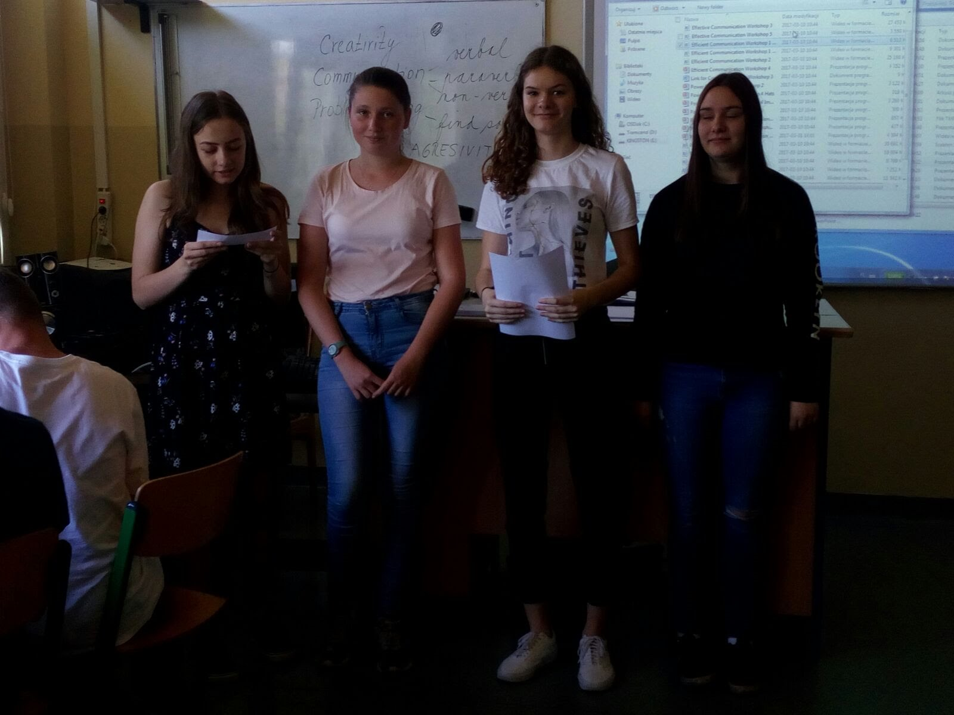
Project Bullying – Skills that Matter beyond Borders
We had lessons with teachers from few countries.

Slide 2
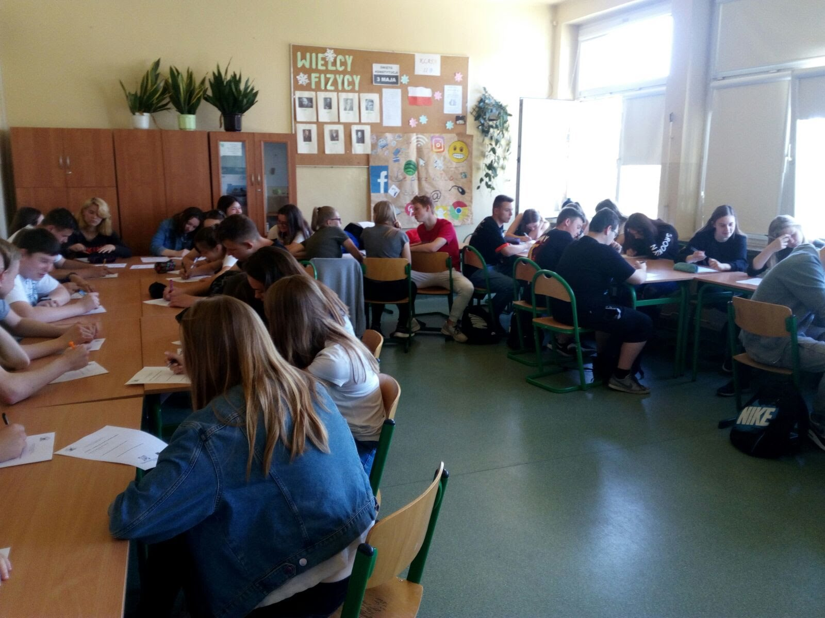
Teachers from Italy, Romania, Czech Republic, Bulgaria came to our school to talk about bullying.

Slide 3
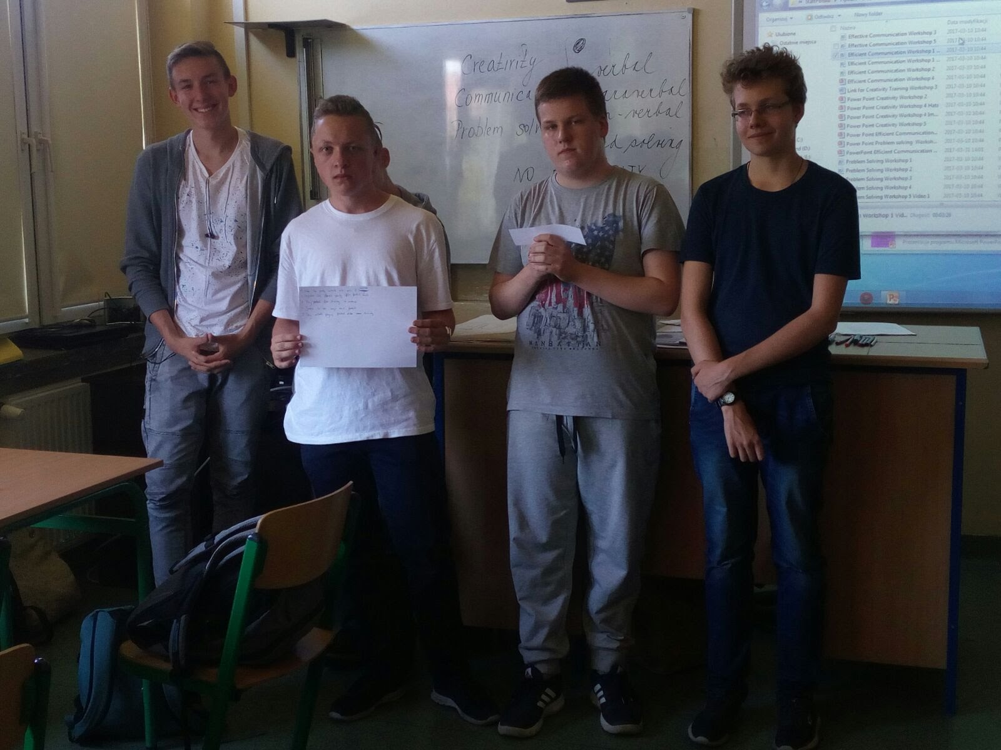
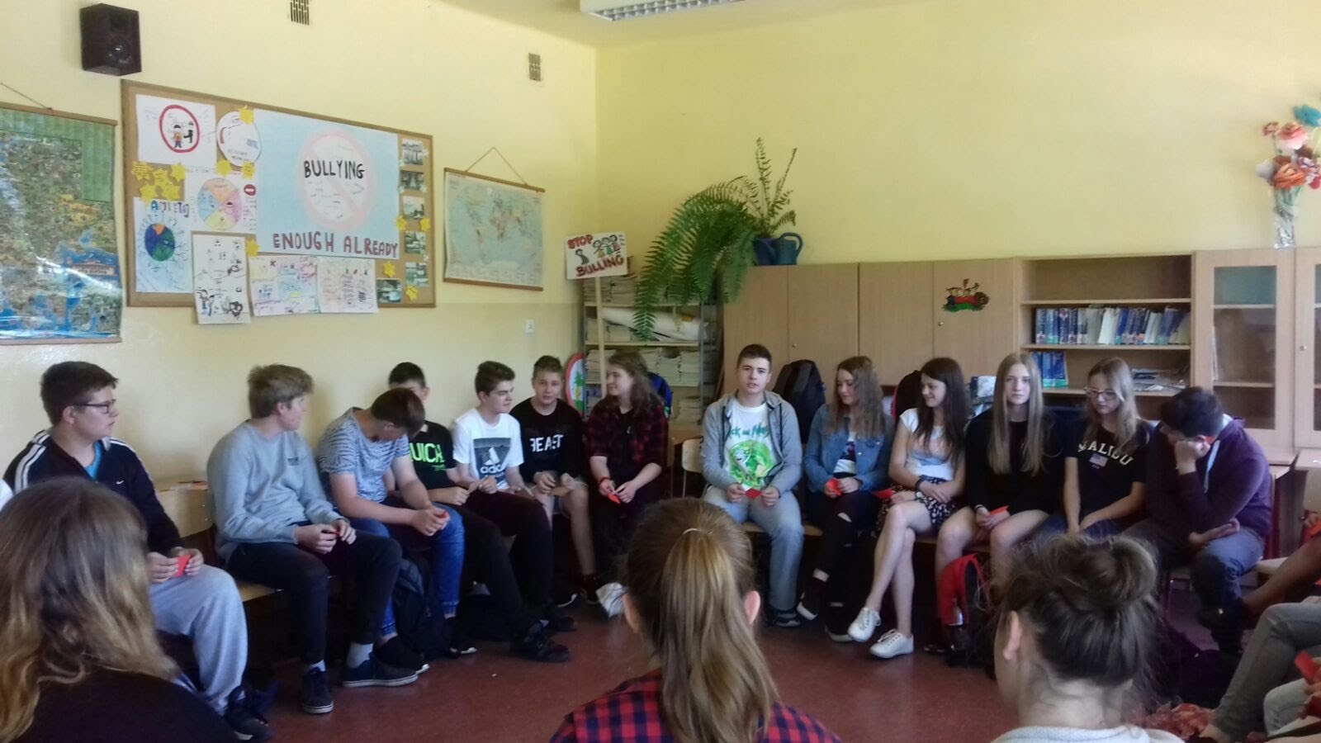

Slide 4
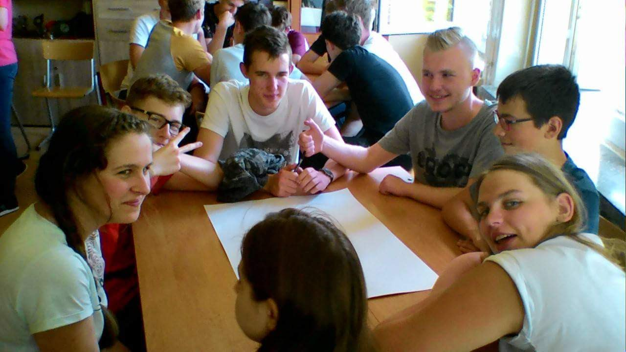
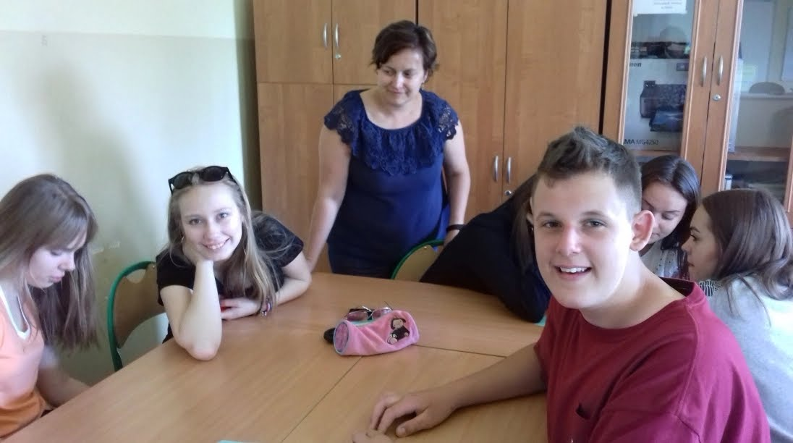

Slide 5
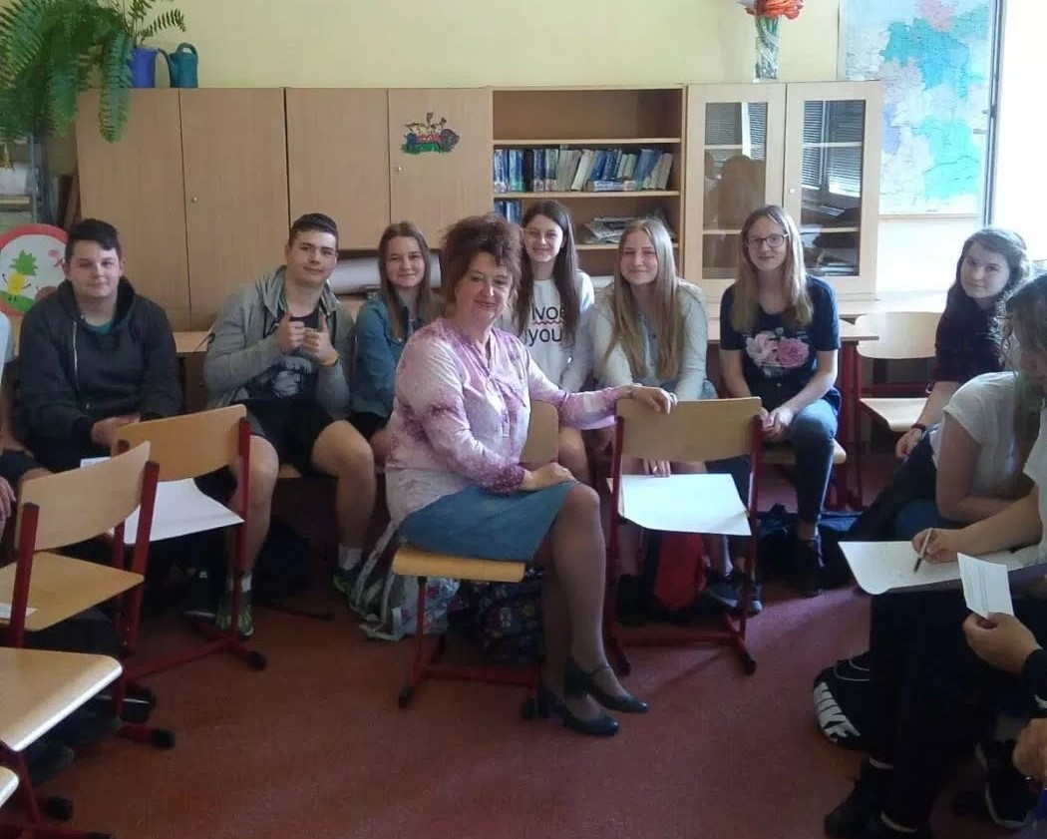
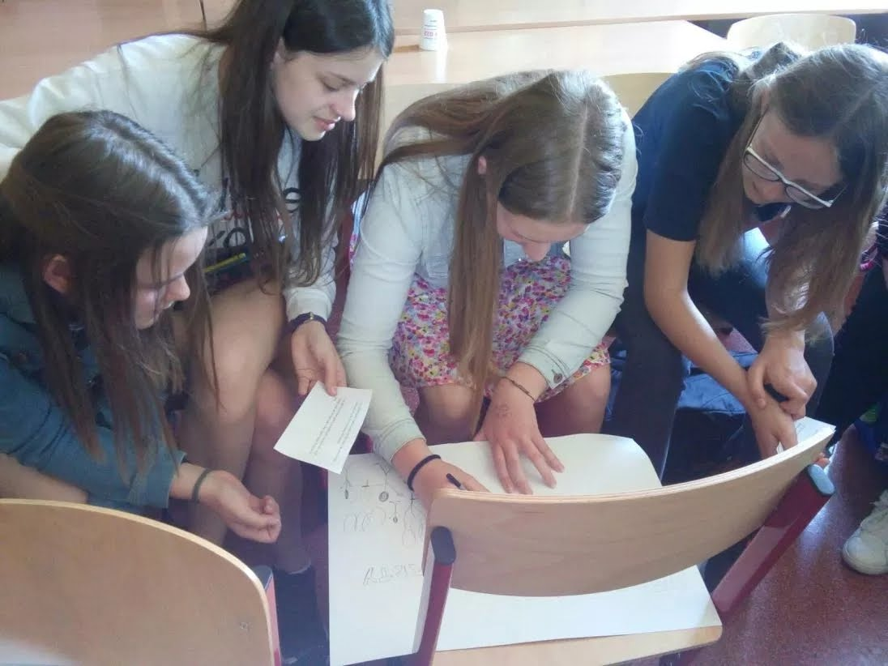

Slide 6
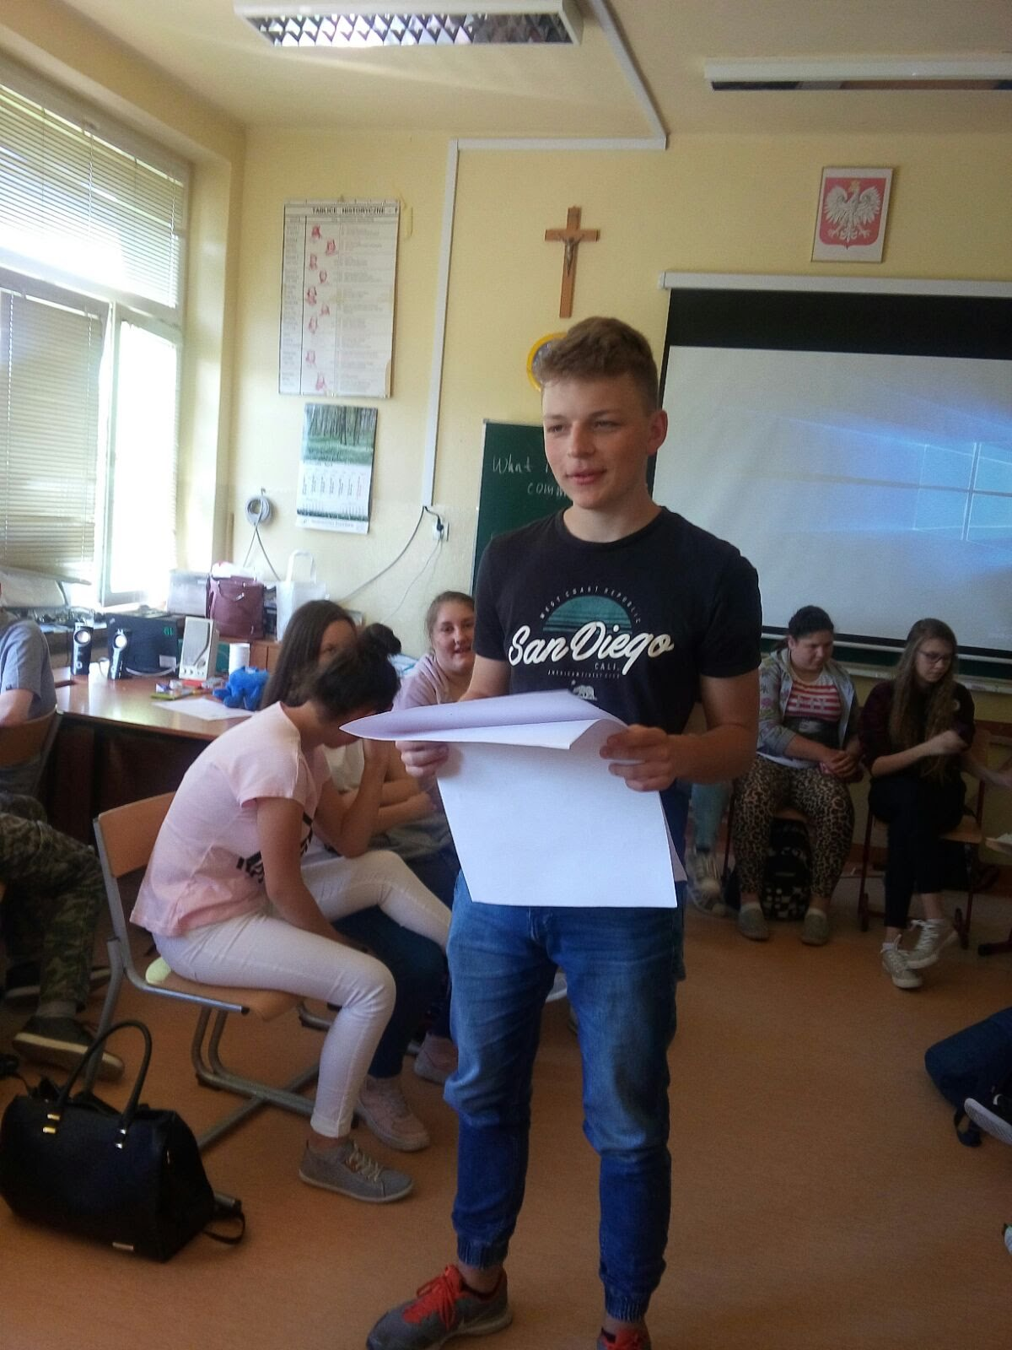
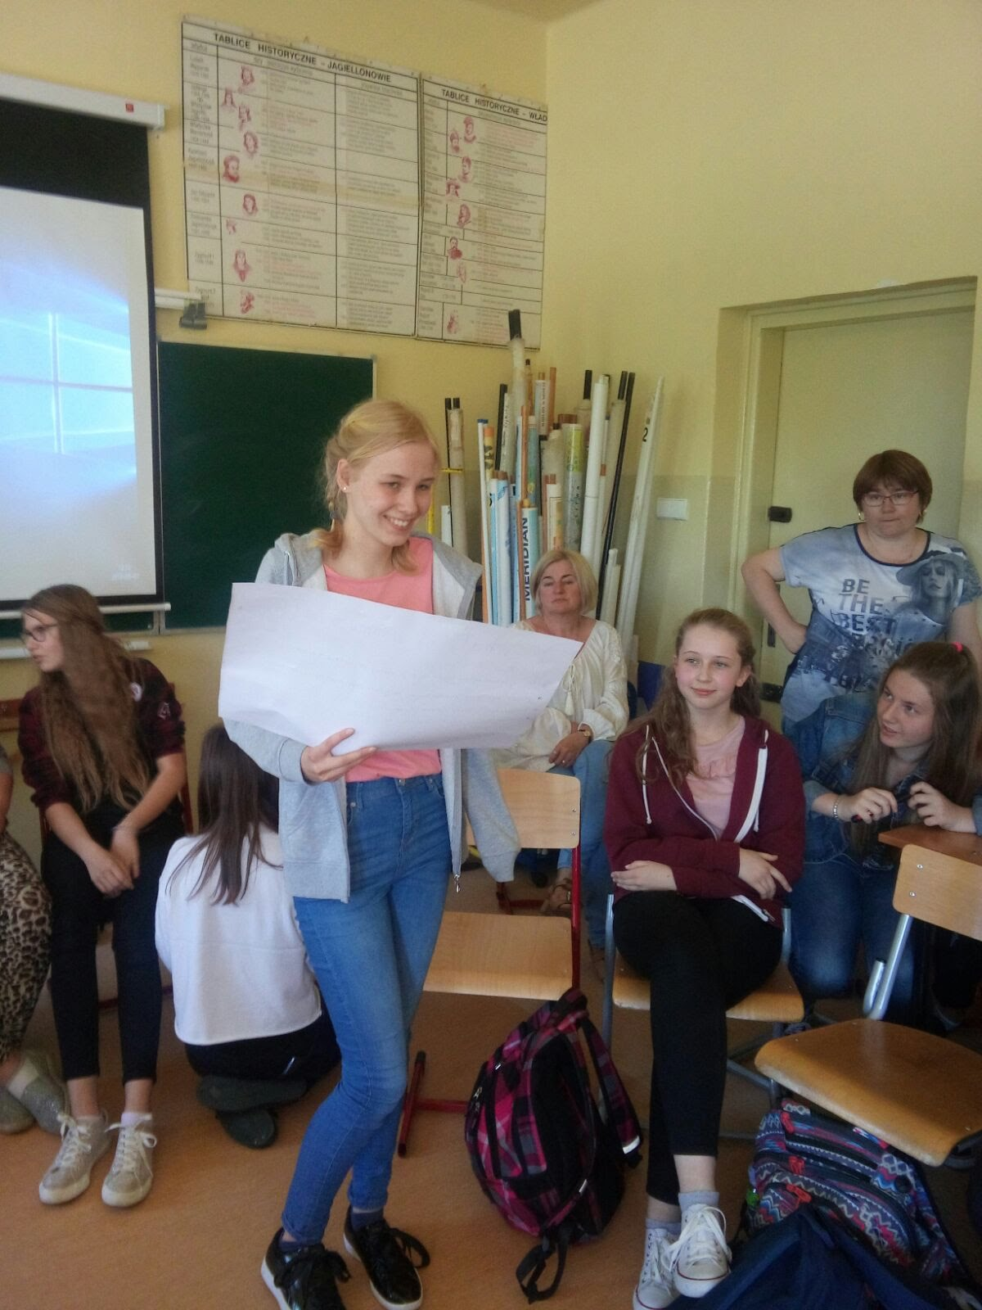

Slide 7

FRIENDSHIP IS:
TRUST
FUN
HELP
LOVE
CONNECTION
RESPECT
HONESTLY

Slide 8
Asia pieprzyk
Jessica jankowska (jj)
Zosia cejzik (cejzor)

